Slide 1
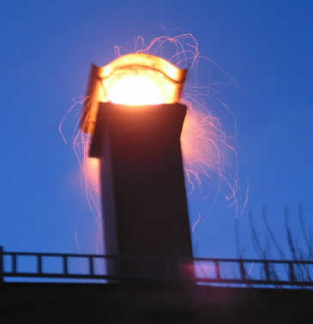
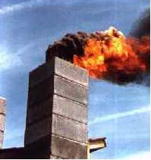
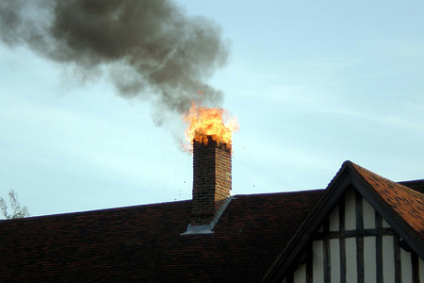
Norfolk Volunteer Fire Department
Chimney
Fires
2018
Training

Slide 2
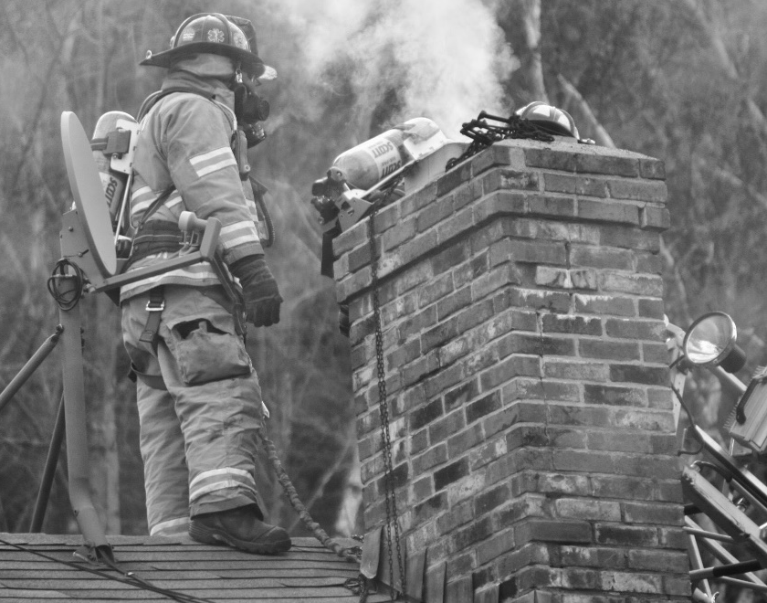
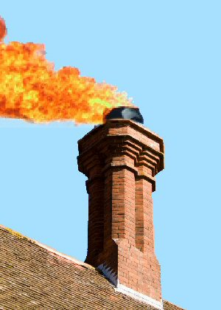
Chimney Fire Definition:
A chimney fire is the combustion of residue deposits referred to as creosote on the inner surfaces of chimney tiles, flue liners, stove pipes, etc.

Slide 3
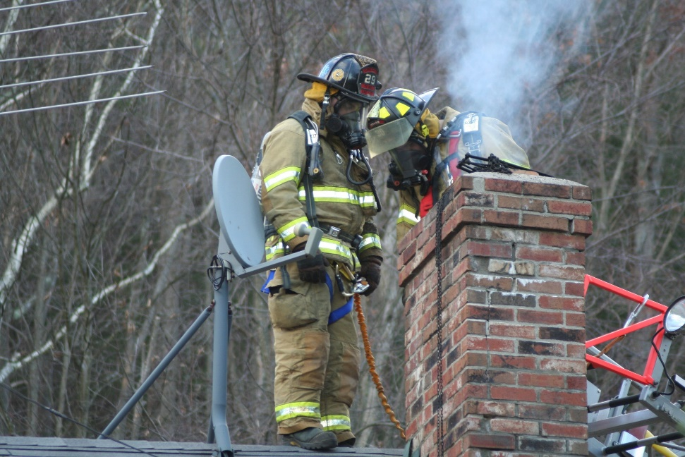
Chimney Fires:
Chimney fires can burn explosively - noisy and dramatic enough to be detected by neighbors or passersby. Flames or dense smoke may shoot from the top of the chimney.
Homeowners may report being startled by a low rumbling sound that reminds them of a freight train or a low flying air plane.
A Chimney fire can quickly ignite asphalt shingles or other combustibles.

Slide 4
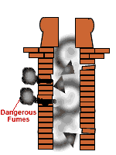
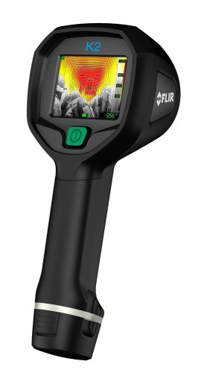
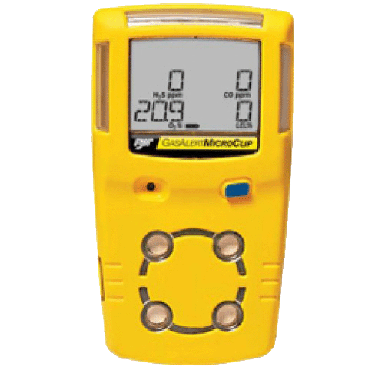
Chimney Fire Hazards:
Failure of the chimney to maintain its integrity, and the spread of fire within adjoining partitions of the structure can quickly escalate into a house fire. Make use of the Thermal Imaging Camera (TIC) to check for any possible extension.
Additional hazards include the possible buildup of toxic gases such as Carbon Monoxide (Co) within the structure due to restricted flues. Always Meter!!

Slide 5
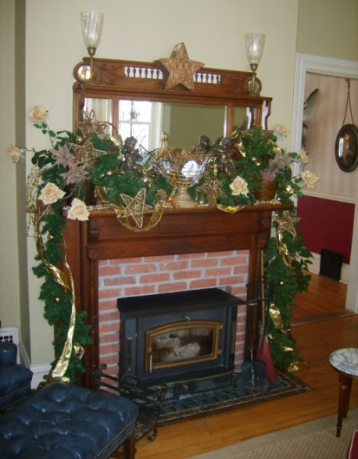
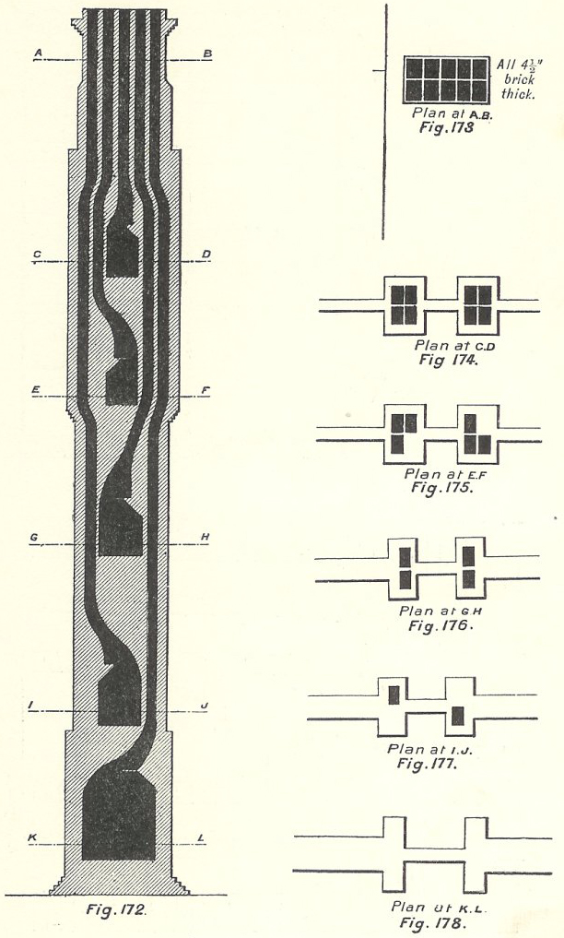
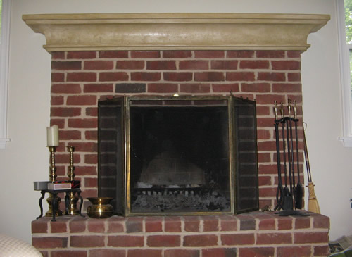
Types of Stoves:
Standard Fire Place and Inserts
Internal Flu Systems
Multi-level houses will have separate flu’s for every fire place

Slide 6
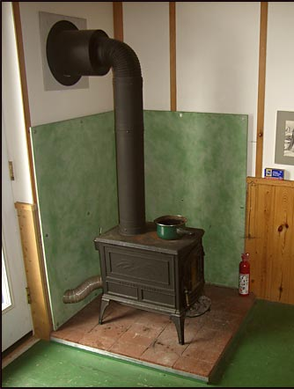
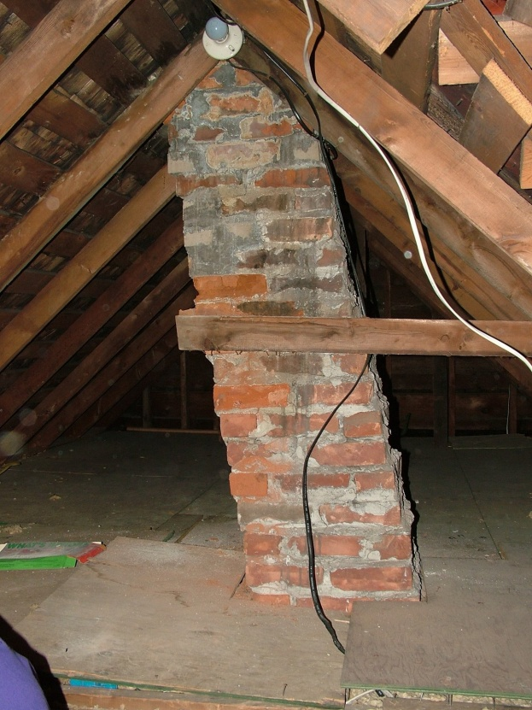
Types of Stoves:
Fire Box
- Exposed Flu pipe into the chimney
Creosote will form heavily at bends in any piping, at angles in a chimney, and where the chimney exits the roof line (Temperature difference creates creosote build up)

Slide 7
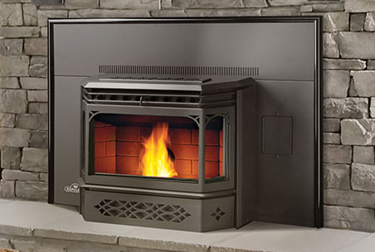
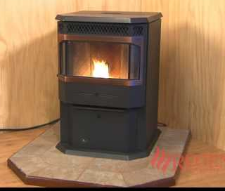
Types of Stoves:
Pellet/Coal Stoves
Inserts or free standing units are common.
Direct Vent thru walls or into chimneys
2 fans: 1 Exhaust fan, 1 Circulator fan (Hot air)
All come with temperature sensors that “Should” shut unit down in case of a malfunction.

Slide 8
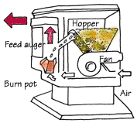
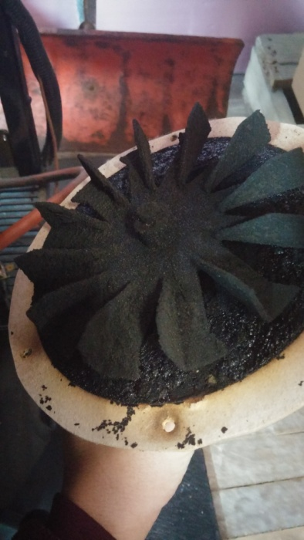
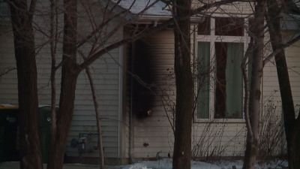
Pellet Stoves:
Concerns:
Broken or cracked front glass
Door Gasket damaged, needs to be sealed for proper operation.
A power failure prevents the exhaust of smoke, filling the house.
Lack of cleaning and maintenance
Not installed properly

Slide 9
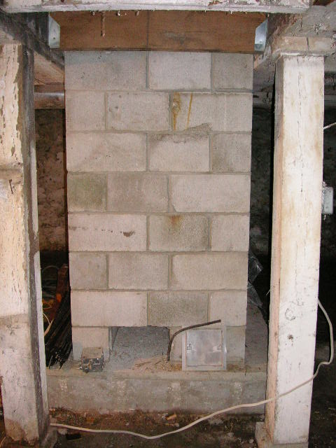
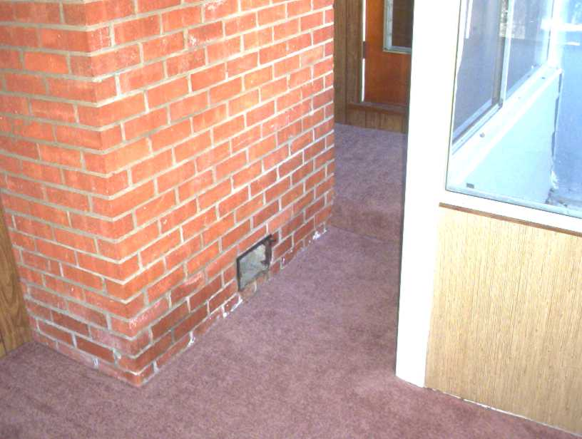
Chimney Cleanouts:
Cleanouts are located at the lower portion of the chimney.
Maybe located outside, under snow and ice.
Cleanouts can cause a fire hazard if not closed and next to combustible materials.

Slide 10
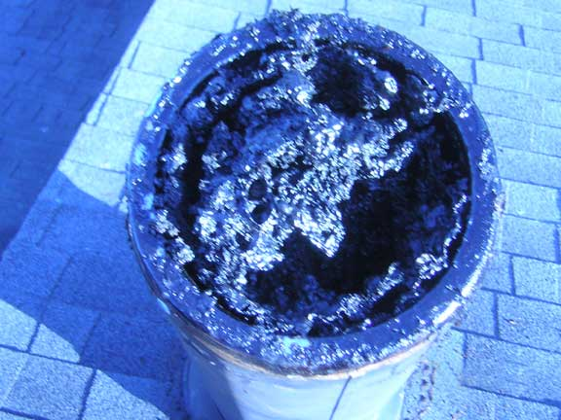
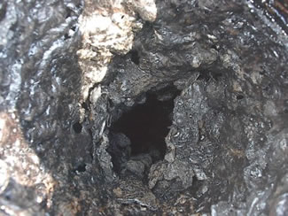
Chimneys and Creosote:
Creosote is black or brown in appearance. It can be crusty and flaky…tar-like, drippy and sticky…or shiny and hardened. Creosote is highly combustible. If it builds up in sufficient quantities – and catches fire inside the chimney flu instead of the firebox of the fireplace or wood stove – the result will be a chimney fire.

Slide 11
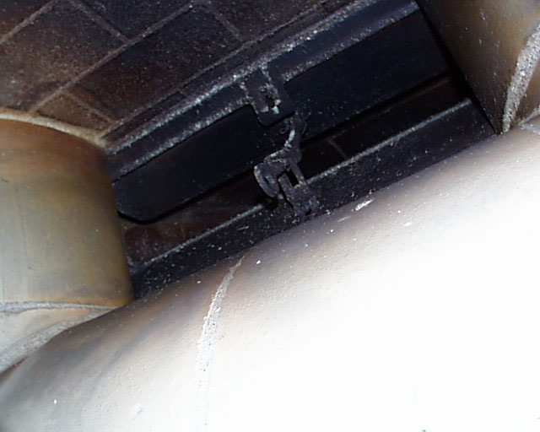
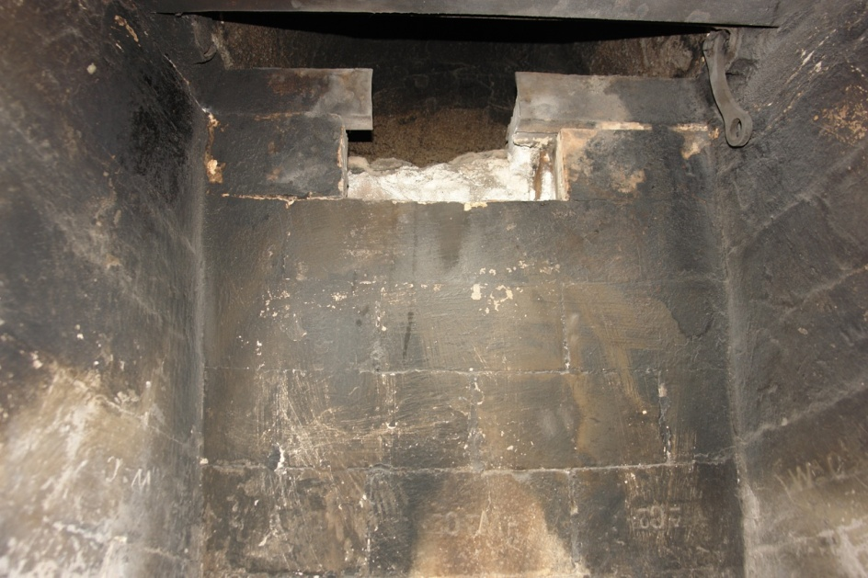
Chimney Damper:
Chimney Dampers are designed to close off the flu, preventing heat from escaping when the fire place is not in-use.
Open Damper Damaged Damper

Slide 12
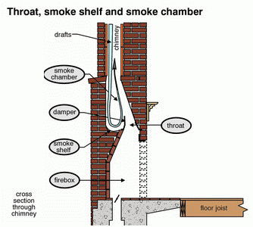
Chimney Shelf:
Burning Creosote will breakaway from chimney and land on the smoke shelf and continue to burn.
The Up-Draft will carry small particles up chimney and re-ignite any un-burnt creosote.

Slide 13
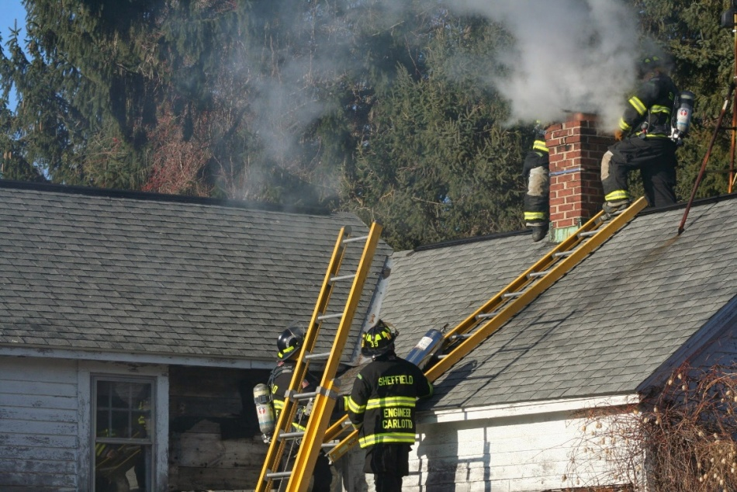
Extinguishing a Chimney Fire
Determine where fire is burning.
Determine if the fire is contained to chimney or flu
Check for extension out of the Chimney. TIC!!
Wear Proper PPE & SCBA when operating near the chimney.
Access to Chimney:
Ground Ladders Aerial Trucks

Slide 14
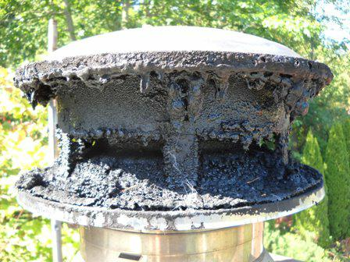
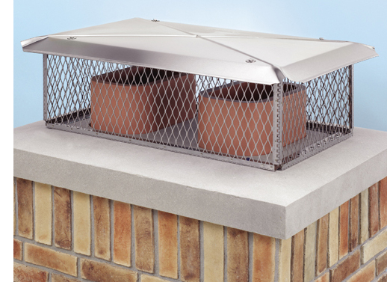
Roof Operations:
Wear proper PPE and your SCBA!
Remove the Chimney cap if necessary
Burning creosote needs to be removed from the chimney and flu.
Stay upwind from the top of the chimney. Don’t stand in the Smoke
Have a hand line ready incase the roof catches fire

Slide 15
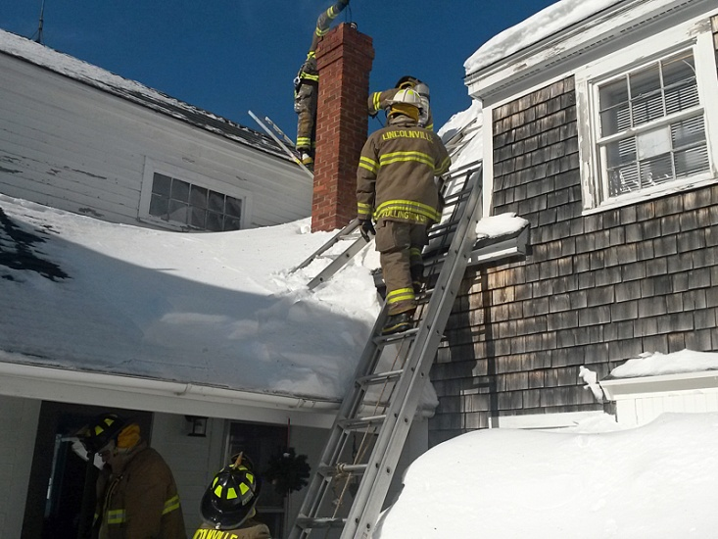
Roof Operations Cont.:
SAFETY ON and OFF THE ROOF!!!
Wear proper PPE and your SCBA!
Roofs are steep and slippery. Maintain contact with the roof ladder or aerial.
Snow and Ice make a dangerous situation, make use of an aerial truck if possible.
Use utility rope to tie off tools from falling.
NEVER STAND BELOW THE ROOF WHERE TOOLS CAN HIT YOU!!

Slide 16
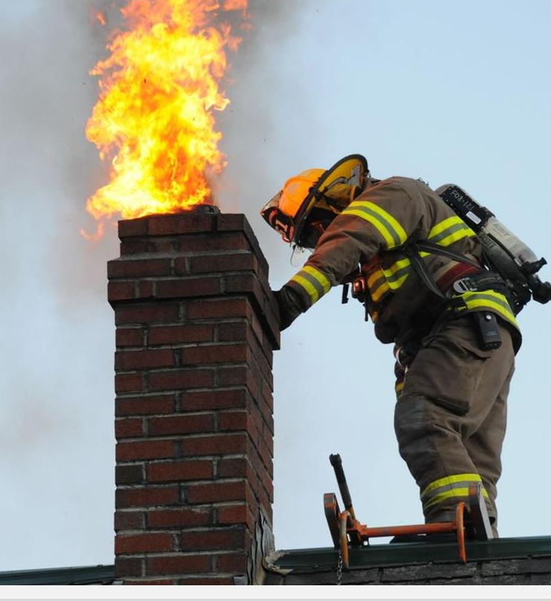
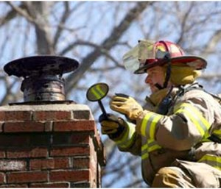
Roof Operations Cont.:
The Natural updraft carries particles out, Never look directly into chimney! Use mirrors to check progress.
The updraft from the chimney also makes spraying water down the chimney less effective than from the bottom up. Misting water is most effective inside only.

Slide 17
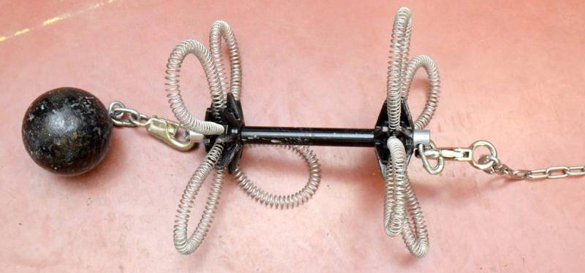
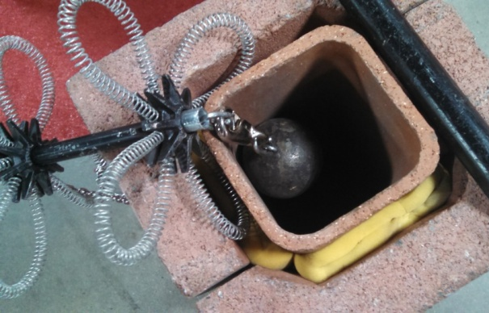
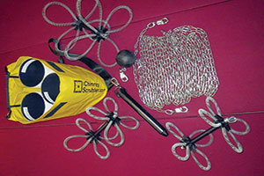
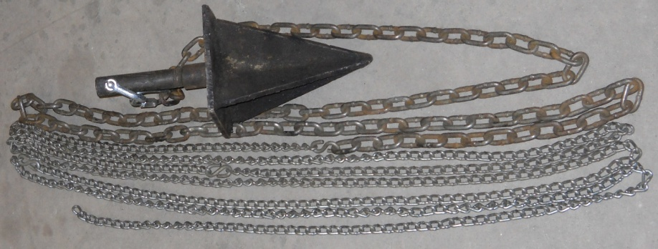
Roof Operations Cont.:
Use of weights and scrubbers will break apart the creosote in the chimney.
Drop the chimney brush until chimney sides are clear of debris and you can see the bottom.

Slide 18
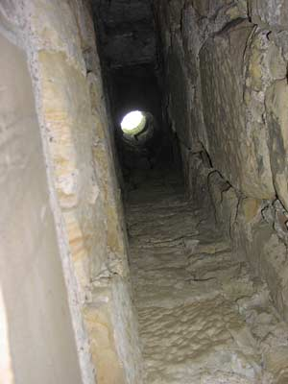
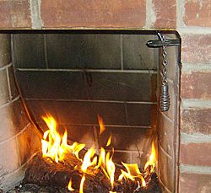
Indoor Operations:
Set up canvas tarps from the fireplace to the exit
Extinguish fire in firebox and clear out the fire shelf
Remove ashes and logs
Work with the roof team to shovel out ashes/embers as they are knocked down
Spray the water can into the chimney and allow steam to extinguish fire (if needed)
Never Look up the chimney, watch for
the falling weight and ashes with mirrors
Wet down the ashes outside

Slide 19
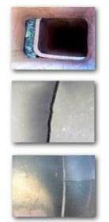
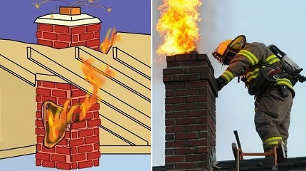
Chimneys can fail due to:
- Damage
Cracks
Excessive Heat
Improper installation

Slide 20
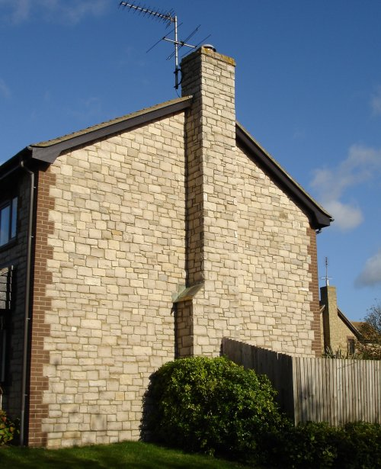
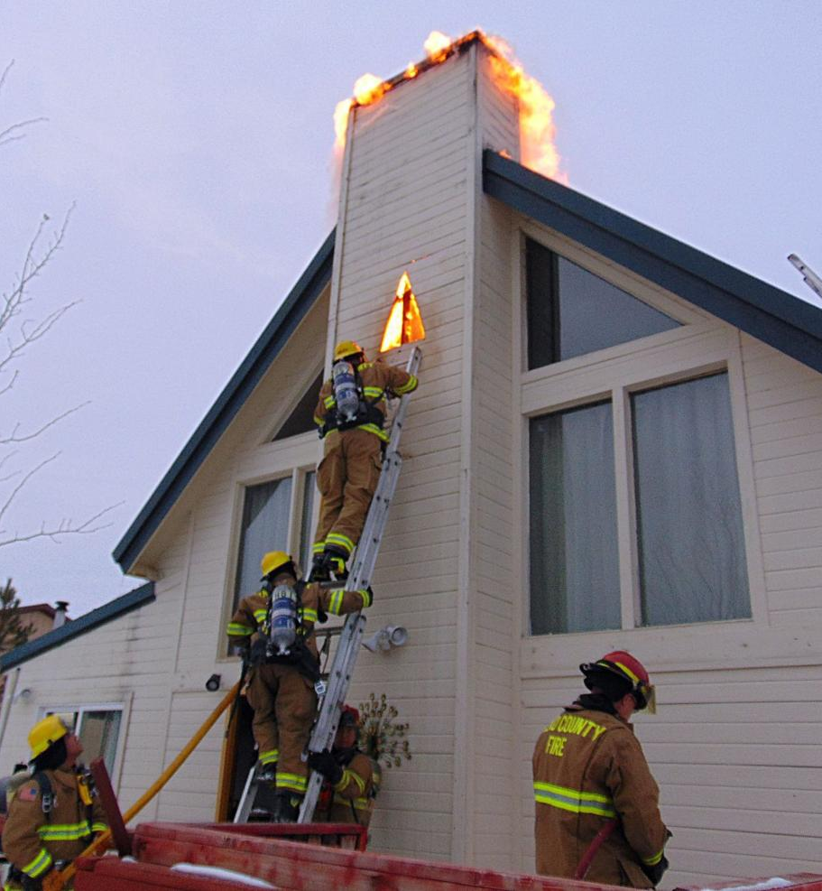
Fire Extension:
Use the Thermal imager on all floors to check for possible extension.

Slide 21
The Homeowner:
Advise the homeowner that even though the fire is extinguished, a thorough cleaning is needed by a professional cleaning company
The fire place should not be used until inspected for any cracks in the chimney liner, missing or damaged bricks, or damage from excessive heat
Report any findings, damage to homeowner
Contact the BUILDING INSPECTOR and/or FIRE MARSHAL if any doubt of improper installation of a stove unit exists

Slide 22
Preventing Chimney Fires
Use seasoned woods only (dryness is more important than hard wood versus soft wood considerations)
Build smaller, hotter fires that burn more completely and produce less smoke
Never burn cardboard boxes, wrapping paper, trash or Christmas trees; these can spark a chimney fire
Install stovepipe thermometers to help monitor flu temperatures where wood stoves are in use, so you can adjust burning practices as needed
Have the chimney inspected and cleaned on a regular basis

Slide 23
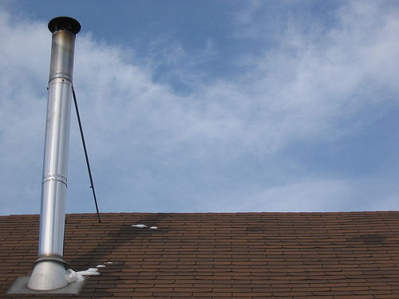
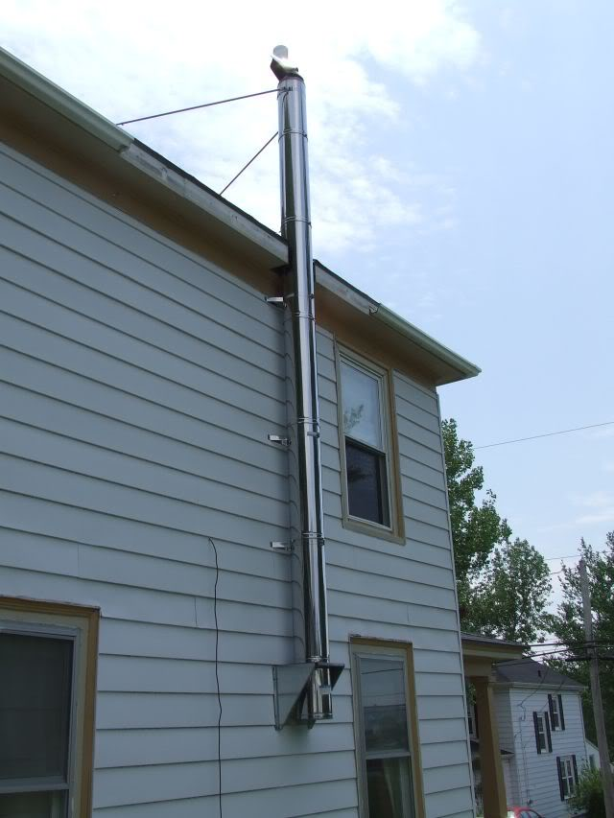
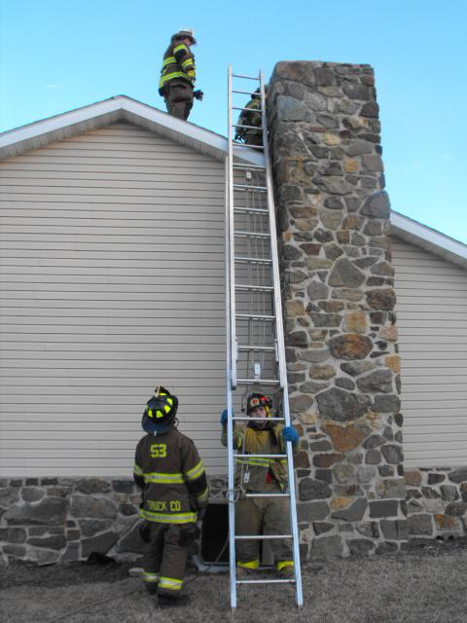
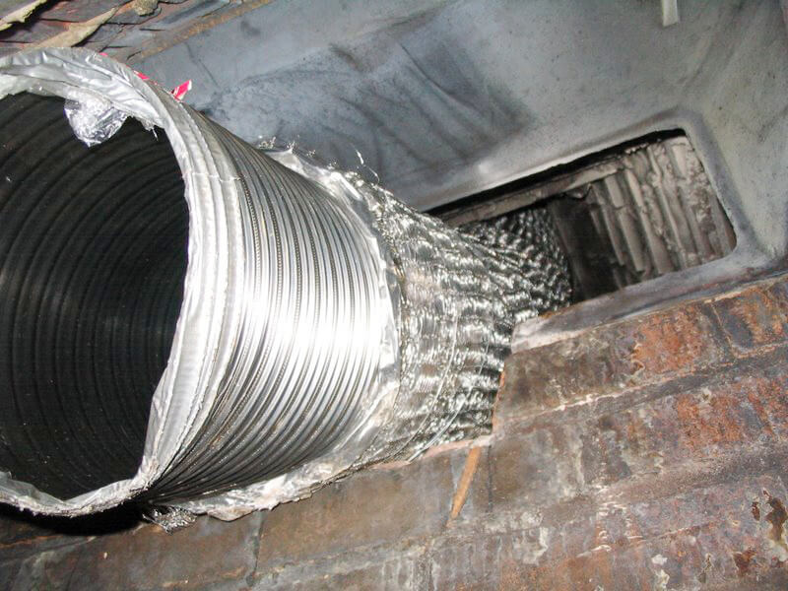
Different Types of Chimneys:

Slide 24
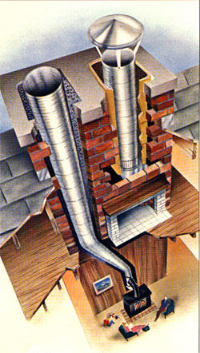
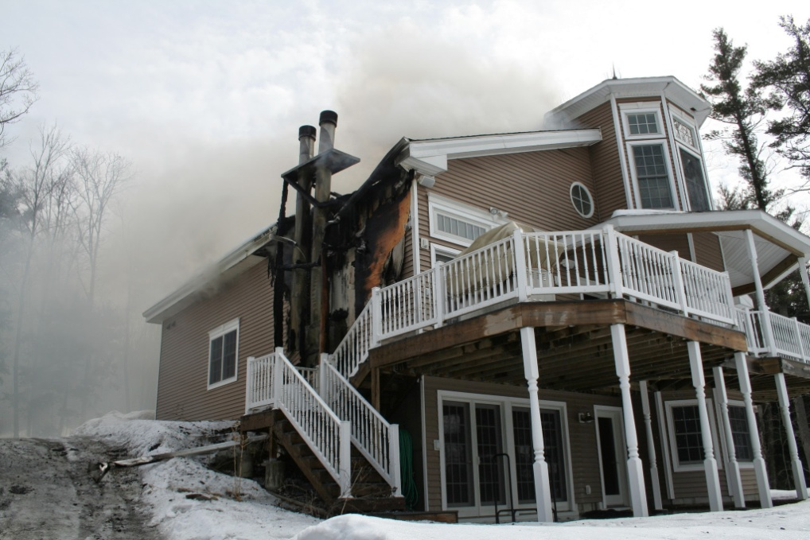
Different Types of Chimneys:
Brick - Metal

Slide 25
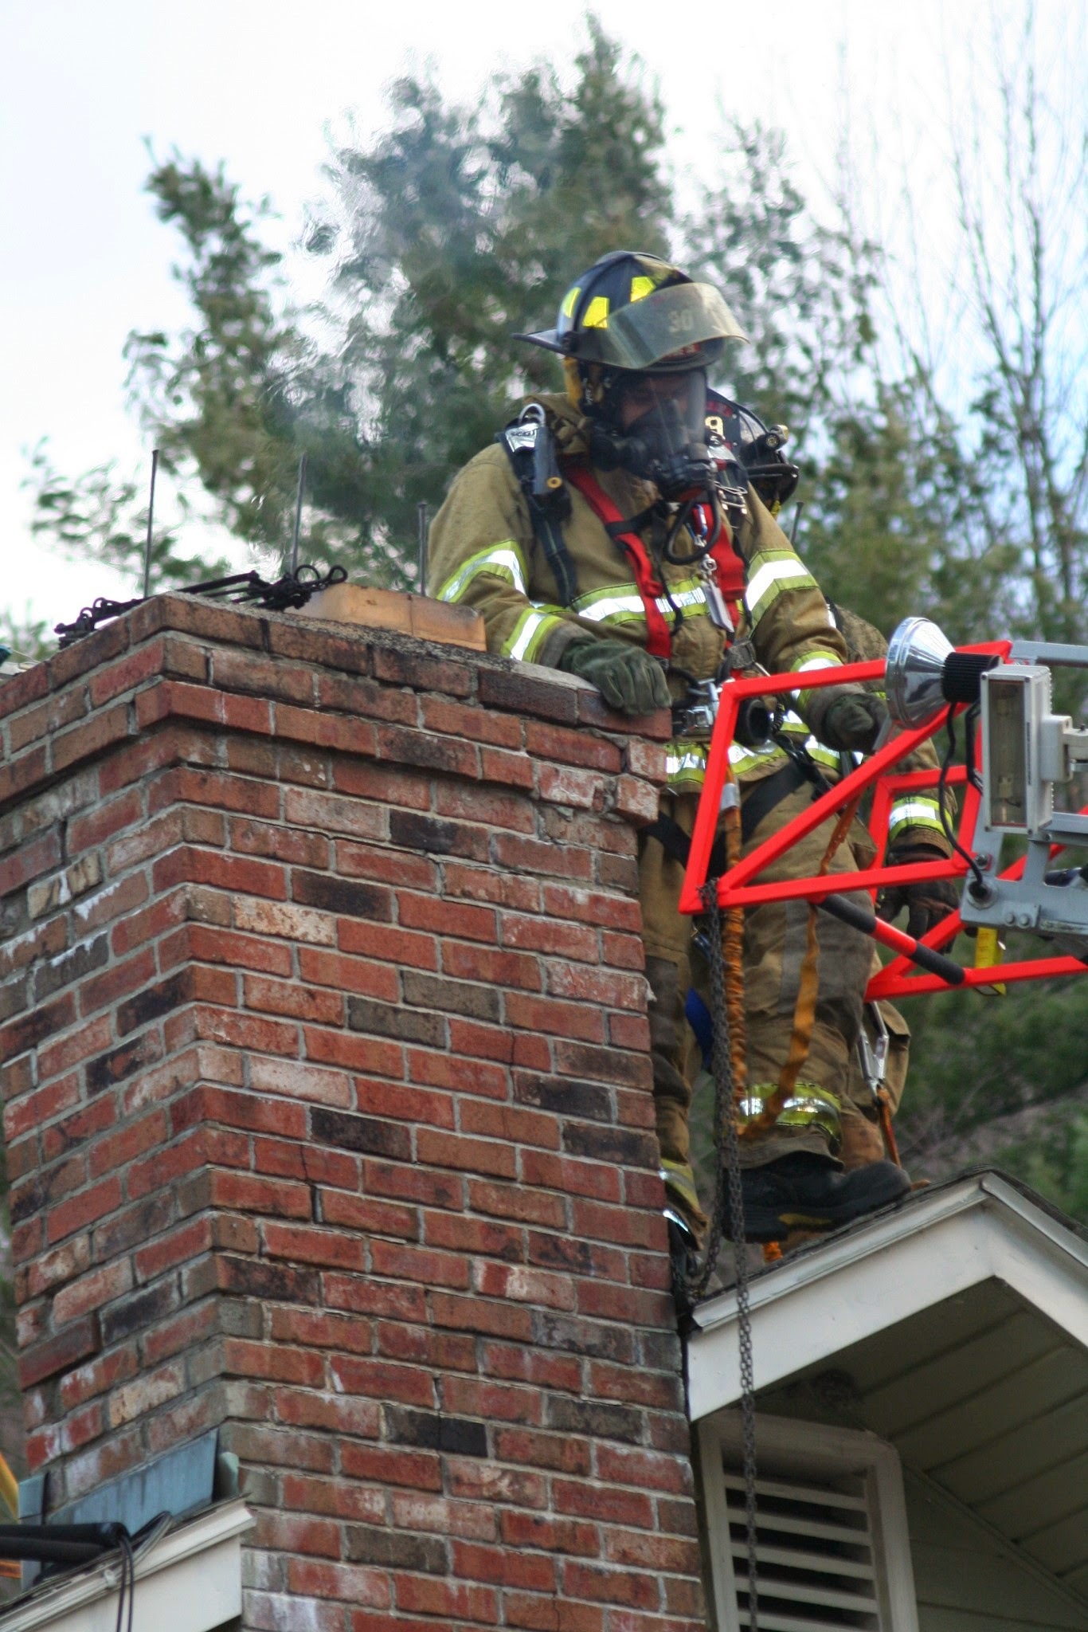
Remember:
MASK UP!

Slide 26
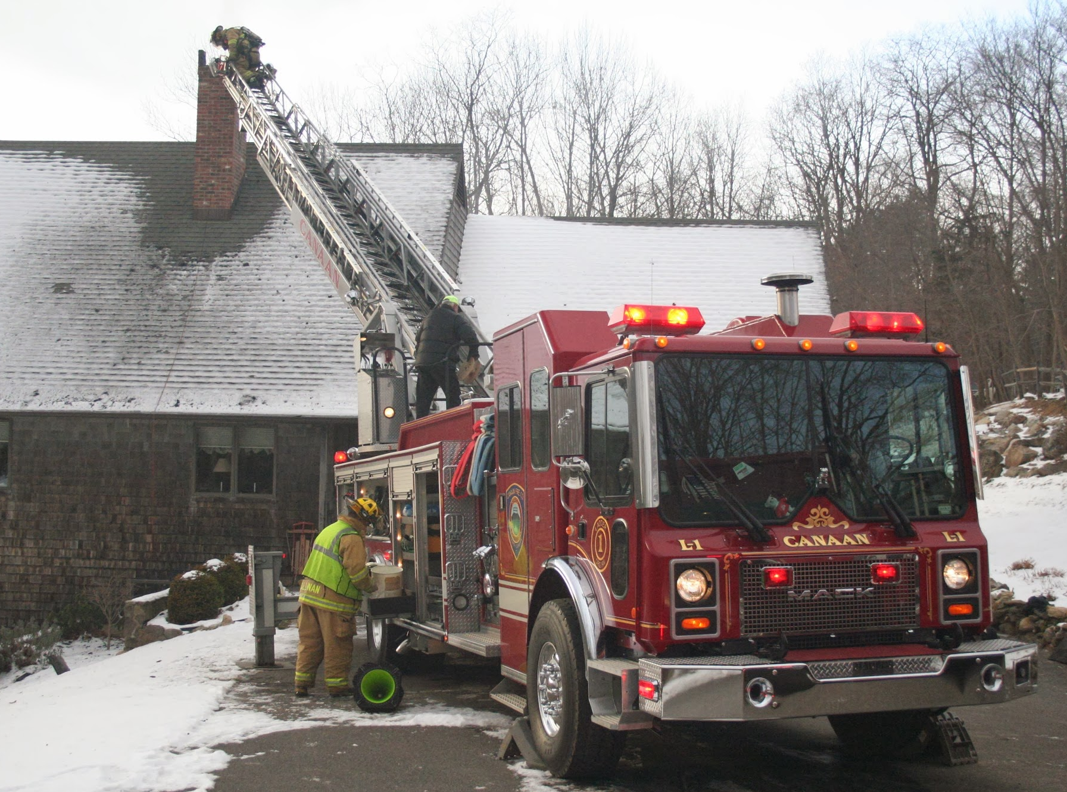
if you can position it near the house, Ladder Trucks offer a safer approach then Ground Ladders.

Slide 27
Have Screw Drivers available to remove Chimney Caps

Slide 29
Pellet Stoves use 3”- 4” double walled exhaust pipe

Slide 30
Wood Burning Stoves use 5” to 10” diameter piping depending on the application

Slide 31
Think it’s a Brick Chimney?

Slide 36
Questions?

